Slide 1
AREI phase two:
DE-risking and the private sector
Dr. Roberto Ridolfi

Slide 2
AREI phase two: de-risking for the private sector
AREI phase two: analysis and reduction of risks is essential to facilitate private investments in Renewable Energy in Africa
Conclusions and recommendations of AREI Forum July 2022
Private sector approach: market challenges risks and returns
Understanding and defining country-level risks
Understanding and defining project risks (to be analysed in conjunction with project preparation )

Slide 3
AREI phase two: De-risking Conclusions 1/4
AREI may and shall:
assist countries to identify the most relevant market challenges via studies and peer to peer:
Inefficiencies in governance of the sector and implementation of policies.
Fitness of business environment.
Fitness of competition and project procurement rules.
Financial sustainability of public off-takers.
Fitness of market structure, legal framework, currency issues.
coherence and transparency of energy regulations regarding private sector participation.
general lack of legal and technical capacities in local institutions to efficiently manage project phases, from preparation to operation

Slide 4
AREI phase two: De-risking Conclusions 2/4
assist governments using peer to peer approaches and examples from African countries complemented by technical assistance:
to display a strong and long-term commitment to the advancement of renewable energy solutions and necessary energy policy reforms.
stabilise national legal and regulatory frameworks avoiding retroactive changes that would impact business models’ stability of projects
in drafting consistent and reliable energy planning methodologies, based on technical capabilities, to support an appropriate energy mix and ensure predictability of country’s strategic choices.
ensure independent capable energy regulatory bodies responsible for good governance of electricity markets and their implementation (i.e., market rules, license issuing, grid codes, etc.).
to make clear to investors which different authority in a country is responsible for which different risk. In this report the various risks were attributed not in general to the public or to governments but specifically to different ministries or agencies.

Slide 5
AREI phase two: De-risking for the private sector 3/4
Promote Domestic resource mobilization at the highest political level to those opportunities exist and to push for:
Fiscal/budget allocation to the RE/EE sector
Potential energy efficiency-related savings
Domestic and regional green bonds
Pension assets: African political and financial authorities should consider reforms and laws aimed at allowing their public pension funds to invest directly in Africa.
Regional/intra-African FDI

Slide 6
AREI phase two: De-risking for the private sector 4/4
assist in the training of officials and dissemination of best practices to analyse and understand project risks in public bodies and agencies

Slide 7
Derisking linked to SDGs: Agenda 2030 as a strong driver for AREI: the rationale
Policy sdg driven incentives
Combine business plan of renewable energy supply with demand
Go beyond financial aspects
Smes can produce
Help assess investors risks and opportunities
Comprehensive cost/benefit analysis (financial, economic, environmental , social and gender)
Innovative financing models
Pay as you go
Fee for service
Crowd funding
Public-private partnerships
Young people get access to markets
Demand creates better business models
Tackling: SDG 7 to have impact on many more sdgs

Slide 8
AREI phase two: De-risking for the private sector
Some market challenges are preventing the further scale-up of IPPS:
an inefficient governance of the sector and implementation of policies.
an unfriendly business environment, most notably for foreign investors.
a lack of transparent competition and project procurement rules.
a weak financial sustainability of public counterparts to offtake energy
high-perceived risk environment linked to perspective investors’ perception of efficiency and reliability of the project-hosting country on market structure, legal framework, currency issues.
coherence and transparency of government policies and regulations regarding power sector governance and private sector participation.
soundness of sectorial development plans and project procurement rules.
weak financial sustainability of public counterparts (off-takers).
general lack of legal and technical capacities in local institutions to efficiently manage project phases, from preparation to operation

Slide 9
De-risking is essential
Pressure from investors and shareholders for increased disclosure and transparency about sustainability in company reporting will drive investors to hold companies accountable.
The financial segment can drive due diligence processes and methodologies, including certification to reduce system costs and encourage standardization towards SDGs. The tools conceived for business will have the same metric of certification, validation schemes to be used in loan appraisal and investment design. Indexes will be based on the same metrics too.
However, we know that the pure private financial sector will not take any more risks tomorrow than those that they are ready to take today .
For this reason, we need to connect the blended finance techniques and the development banks world to the commercial finance in a way that is instrumental to the policy incentives and the schemes that public authorities will decide to implement.

Slide 10
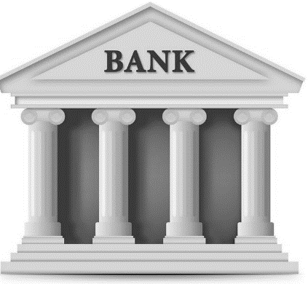
SUSTAINABLE INVESTMENTS
AREI phase two: Elements for a strategy : private sector on sustainable finance
move beyond
L’IMPULSION POLITIQUE
towards
INVESTMENT PUSH
Impact investing
Benefit-driven business models
Creation of enabling environment
The development of a new ecosystem is necessary policy alone will not be sufficient.
The centrality of finance institutions and commercial banks is crucial to enhance sustainable investments

Slide 11
Institutional framework risks of countries
The diversity of countries and the different political structures and approaches make it hard to propose a single framework. However, there are some common and fundamental aspects:
• governments and public institutions to display a strong and long-term commitment to the advancement of renewable energy solutions and necessary energy policy reforms.
• national legal and regulatory framework to be stable, clear, and transparent, avoiding retroactive changes that would impact business models’ stability of projects.
• consistent and reliable energy planning methodologies, based on technical capabilities, to support an appropriate energy mix and ensure predictability of country’s strategic choices.
• independent capable energy regulatory bodies responsible for good governance of electricity markets and their implementation (i.e., market rules, license issuing, grid codes, etc.).
• energy planning institutions dedicated to identifying the necessary investments to meet the projected demand at the lowest cost.

Slide 12
AREI has carried out a study in MAY 21 on the uptake of policies (general RE policies not for private sector investments)

Slide 13
I start de-risking if I know where are the risks. Which ministry and on which desk my energy investment dossier is blocked?
Investors need to know which different authority in a country is responsible for which different risk
Various ministries hold the following risks:
Land rights
Local labour content
Technology transfer requirements
Licensing/permitting
Host country law imposed for dispute resolution
Investment laws

Slide 14
Understanding and defining country-level risks
The Ministry of finance, fiscal agencies, and the central bank hold the following risks:
Investment laws
Import duties
Withholding taxes
Foreign exchange: availability, convertibility and transferability

Slide 15
Understanding and defining country-level risks
Ministry of energy and/or authorities emanated from it such as regulators utilities agencies etc, hold the following risks:
Generation-intermittency
Transmission-connectivity
Distribution-payment collection
We need RE /EE institutions able to perform the work.

Slide 16
AREI phase two: risks directly linked to the project
Before the project materialise, we have the fundamental issue of procurement.
How many MWs are to be installed? By when? What is the process to procure them?
The adoption of a transparent and, as much as possible, competitive procurement procedure to allow governments to procure the best infrastructure at the least cost, and to allow project developers to benefit from the advantages of a common and level playing field can reduce the procurement risks.
PPPs policies are as good as the people posted to implement them. Fine lawyers, fine financial and technical specialists in the negotiating role are desperately needed and to a certain extent they must be in-house. In procurement the value chain of energy needs to be defined. How the MW will be evacuated? Transmission lines, sub-stations, and a grid that can evacuate energy without destabilization or cuts.
The case of Turkana wind project in Kenya has demonstrated this.
Guidelines for successful PPP implementation, European Commission, 2003 edit. R Ridolfi https://ec.europa.eu/regional_policy/sources/docgener/guides/ppp_en.pdf

Slide 17
AREI phase two: execution risks
The private sector holds the following risks (some of them must be hedged completely if we want to see the project to materialise) We distinguish during construction:
Cost overruns
Delays
Performance shortfall
Expropriation/nationalization risk
Site selection risk
Land dispute risk
A way to address the execution risks is an EPC contract (engineering/procurement/ construction) that envisages penalties and liquidated damages for a delay in the construction or cost overruns and ensures that these risks are totally or partially transferred from the project to the EPC contractor.

Slide 18
AREI phase two: De-risking project risks
During management we have different risks:
Expropriation
Nationalization
Strikes
Riots
War
Sabotage & terrorism
A good quality PPA contract to define and secure project revenue streams, typically requiring the off taker to buy all or most of the electricity produced at a pre-determined price can reduce these risks.

Slide 19
AREI phase two: a good PPA
Some forms of indexation, either to a hard currency and/or to inflation, to ensure the adequacy of revenue streams defined by the PPA may reduce the currency risk further.
Contractual provisions, also considered inside the PPA structure, must deal with some other important risks, such as curtailment compensation, force majeure (typically exempting both parties from their obligations for a limited period) and termination (covering the default risk from either the off-taker or the generator side).
Risks within the off taker of the PPA:
Revenue flow
Off-taker creditworthiness/payment risk
Termination payment risk

Slide 20
AREI phase two: the core of the problem: OFF-TAKERS
OFF-TAKERS Public utilities in Africa face a multitude of challenges which undermine their financial stability.
One way of addressing this is for governments to provide public counter-guarantees on the off-take payments.
Risks with lenders
Debt
Foreign exchange
Availability risk
Convertibility risk
Transferability risk
In many African countries, strong political direction, and budgetary/fiscal allocations to the sector, via renewable access energy funds are critical and are one of the most important objectives of AREI phase 2.

Slide 21
The lesson from the analysis of existing de-risking schemes and tools is that we need one stop shop where all these are offered. Otherwise, different procedures by donors and lenders, different timing different political priorities will make the project derailing.
Some practical principles that must direct actions emerge as conclusions from the analysis and understanding of project related risks.
project risks are typically best addressed by those entities most suited to bear and manage them,
(ii)finding appropriate risk coverage is clearly fundamental to the ultimate success or failure of a project, successfully achieving this will also require a high degree of collaboration and cooperation amongst all project stakeholders
effective and locally fit-for-purpose risk mitigation products and de-risking instruments will be fundamental to build other success stories.
The provision of these products and instruments can then create the market conditions for more attractive risk/reward profiles, helping to shift an unattractive investment opportunity into a commercially attractive one in the minds of private investors

Slide 22
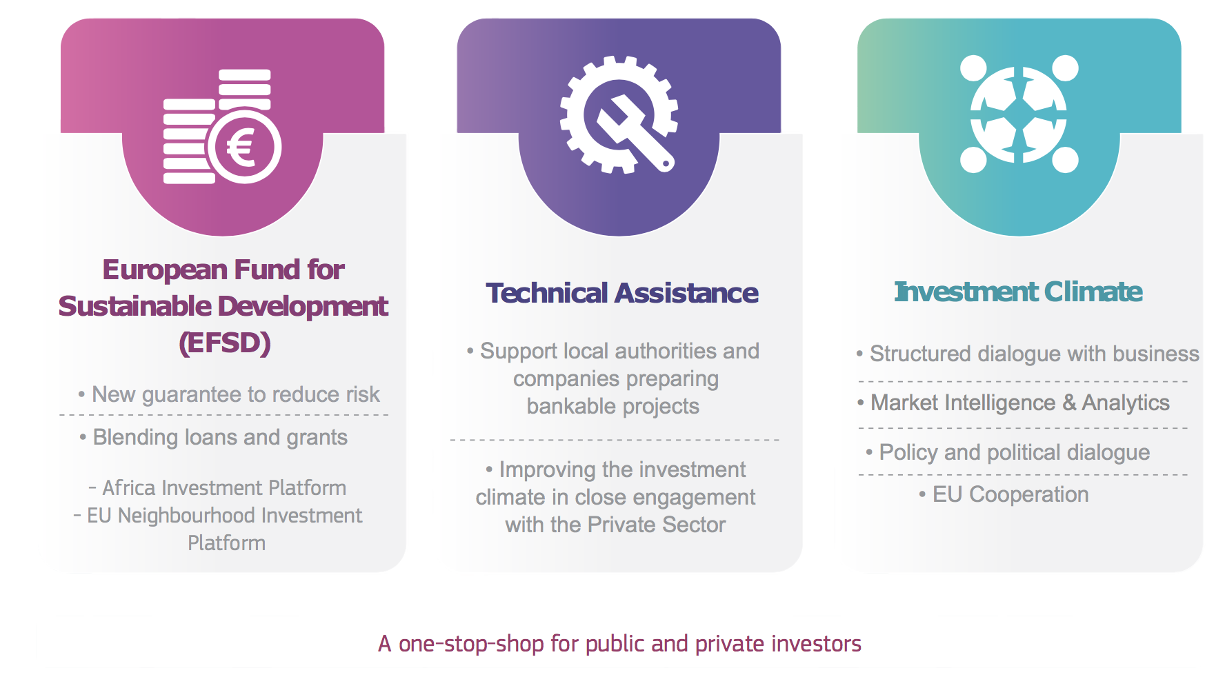
Investment push policy pull and …….money
Blending :How to move on? An example the European Investment Plan: Three Pillar Approach

Slide 23
EU-External Investment Plan Pillar 1 - Resources from EU and leverage

Slide 24
AREI PHASE TWO: THE PUBLIC ACTION TO MOBILISE PRIVATE INVESTMENTS
Policy and political dialogue within African countries countries
Enable business to operate formally, increase the level of investment and innovation, encourage the creation of jobs
Reducing business costs
Reducing risks and uncertainty
Addressing anti-competitive behaviour and opening up markets
Policy and political dialogue within African countries countries
Enable business to operate formally, increase the level of investment and innovation, encourage the creation of jobs
Reducing business costs
Reducing risks and uncertainty
Addressing anti-competitive behaviour and opening up markets
Policy and political dialogue within African countries countries
Enable business to operate formally, increase the level of investment and innovation, encourage the creation of jobs
Reducing business costs
Reducing risks and uncertainty
Addressing anti-competitive behaviour and opening up markets
Structured dialogue with business
United voice for the local private sector – advocacy, networking and exchange of information
Informed policy dialogue on the business environment
Business fora - important partners in supporting partner country development AND the partnerships of foreign businesses
Structured dialogue with business
United voice for the local private sector – advocacy, networking and exchange of information
Informed policy dialogue on the business environment
Business fora - important partners in supporting partner country development AND the partnerships of foreign businesses
Structured dialogue with business
United voice for the local private sector – advocacy, networking and exchange of information
Informed policy dialogue on the business environment
Business fora - important partners in supporting partner country development AND the partnerships of foreign businesses
Country wide energy policy value chains analysis
- Intelligence: regulatory environment, judicial security, contract enforcement, investment protection, skills, market intelligence, land tenure, access to finance, etc
Broader investment climate (financial markets, rule of law, political stability, logistics, infrastructure, etc)
RE and EE specific constraints
Country wide energy policy value chains analysis
- Intelligence: regulatory environment, judicial security, contract enforcement, investment protection, skills, market intelligence, land tenure, access to finance, etc
Broader investment climate (financial markets, rule of law, political stability, logistics, infrastructure, etc)
RE and EE specific constraints
Country wide energy policy value chains analysis
- Intelligence: regulatory environment, judicial security, contract enforcement, investment protection, skills, market intelligence, land tenure, access to finance, etc
Broader investment climate (financial markets, rule of law, political stability, logistics, infrastructure, etc)
RE and EE specific constraints
Coordination and coherence
Look for different initiative contributions (project prep , DRM, TA on policy)
Key role for political support to financial and technical initiatives
African initiatives coordination
Coordination and coherence
Look for different initiative contributions (project prep , DRM, TA on policy)
Key role for political support to financial and technical initiatives
African initiatives coordination
Coordination and coherence
Look for different initiative contributions (project prep , DRM, TA on policy)
Key role for political support to financial and technical initiatives
African initiatives coordination

Slide 25
AREI phase two: De-risking for the private sector
Thank you

